Slide 1

NeuroFleetX Taxi Fleet Manager
Presented by [Akhilesh singh]

Slide 2

Dashboard Overview
Central Control Panel for Fleet Operations
The dashboard serves as a central hub for fleet managers, providing real- time visibility into taxi statuses, metrics, and performance, facilitating informed, data-driven decision-making for optimal fleet management.
2

Slide 3
Key Functionalities
Essential features of the dashboard
Dynamic Visualization
Interactive Widgets
Real-Time Updates
The dashboard offers dynamic data visualization through interactive graphs and charts, enabling fleet managers to quickly grasp performance metrics and trends relevant to their operations.
Users can utilize interactive widgets that allow them to filter and sort ride and taxi data efficiently, enhancing their ability to make informed, data-driven decisions.
With real-time updates powered by Axios, the dashboard ensures that fleet managers have access to the latest information regarding taxi statuses and operational metrics at all times.
3

Slide 4

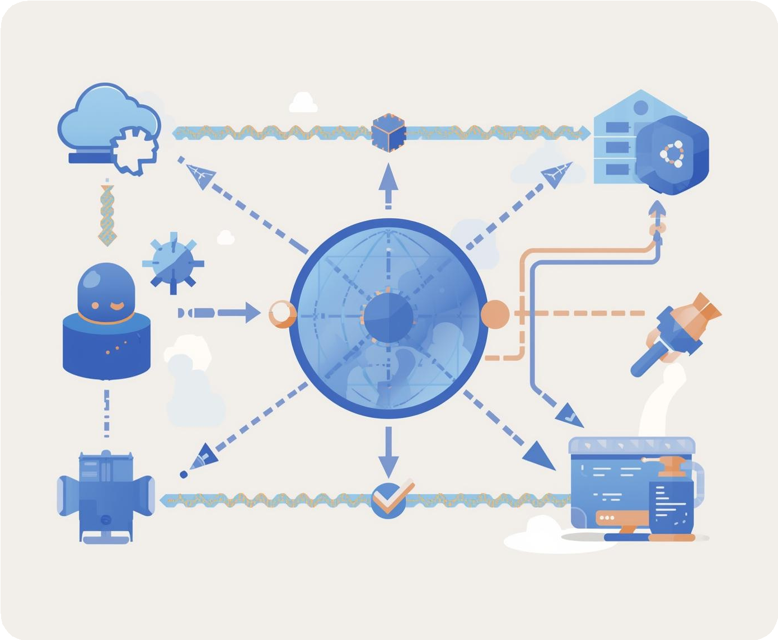

Frontend Technology Stack
Key Technologies for Dashboard Implementation
The dashboard leverages React, Vite, and Tailwind CSS for a responsive and efficient user experience while utilizing Axios for seamless data integration with backend APIs.
4

Slide 5
CSV Upload Features
Streamlining Data Management Processes
Dataset Upload
Validation
Model Metrics
The CSV Upload page enables fleet managers to easily upload datasets, facilitating efficient retraining of ETA models. This functionality ensures timely updates to predictive analytics for improved decision-making.
Before processing, the system performs validation checks on uploaded files to identify errors or inconsistencies, allowing users to rectify issues and ensure high-quality data for model training.
After retraining, the upload page displays updated model performance metrics, such as R², RMSE, and MAE, providing insights into the model's accuracy and effectiveness for fleet operations.
5

Slide 6
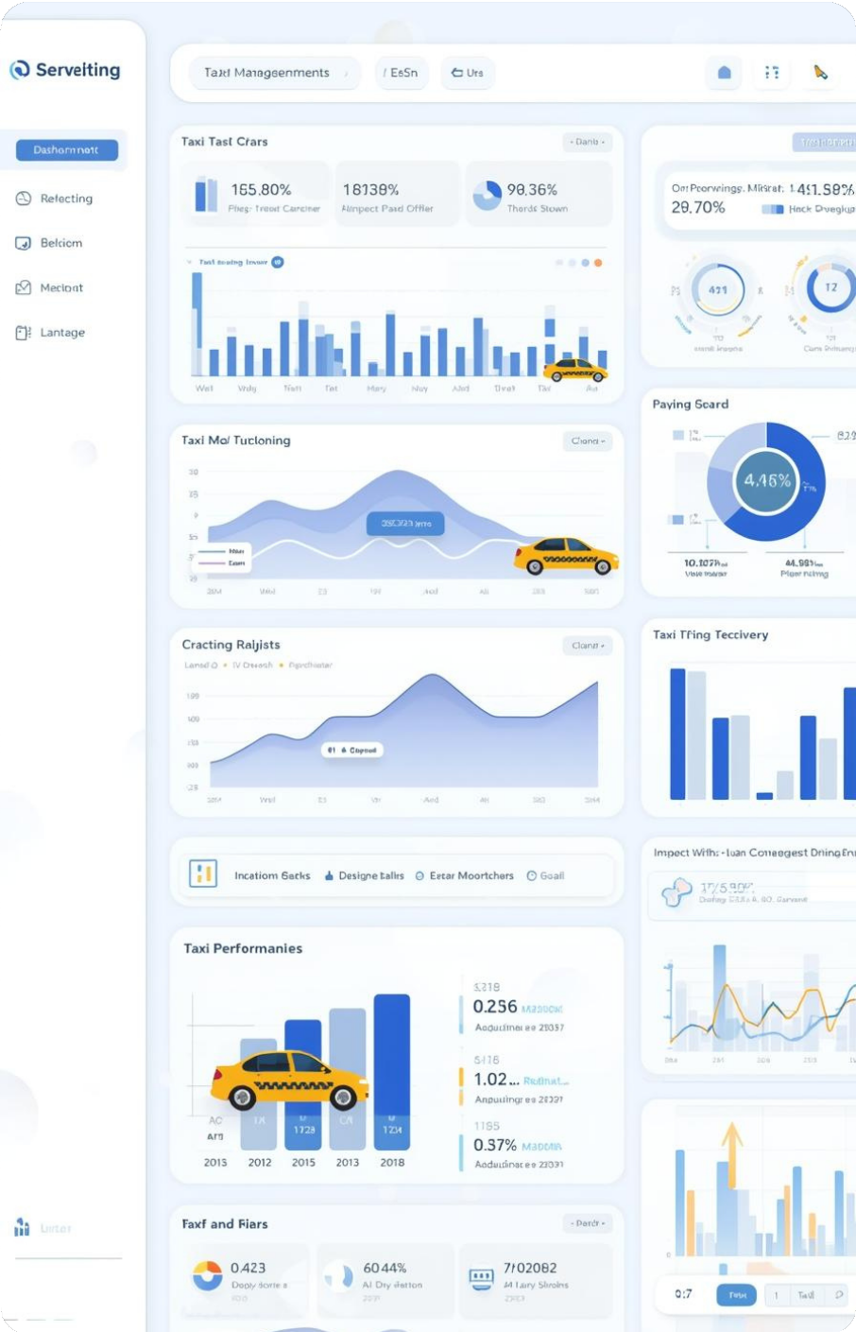

Technology Stack
Streamlining Data Management Efficiency

